Slide 1

Parallel Programming in C with MPI and OpenMP
Michael J. Quinn

Slide 2
Chapter 12
Solving Linear Systems

Slide 3
Outline
Terminology
Back substitution
Gaussian elimination
Jacobi method
Conjugate gradient method

Slide 4
Terminology
System of linear equations
  Solve Ax = b for x
Special matrices
  Upper triangular
  Lower triangular
  Diagonally dominant
  Symmetric

Slide 5
Upper Triangular
4
2
-1
5
9
2
0
-4
5
6
0
-4
0
0
3
2
4
6
0
0
0
0
9
2
0
0
0
0
8
7
0
0
0
0
0
2

Slide 6
Lower Triangular
4
0
0
0
0
0
0
0
0
0
0
0
5
4
3
0
0
0
2
6
2
3
0
0
8
-2
0
1
8
0
-3
5
7
9
5
2

Slide 7
Diagonally Dominant
19
0
2
2
0
6
0
-15
2
0
-3
0
5
4
22
-1
0
4
2
3
2
13
0
-5
5
-2
0
1
16
0
-3
5
5
3
5
-32

Slide 8
Symmetric
3
0
5
2
0
6
0
7
4
3
-3
5
5
4
0
-1
0
4
2
3
-1
9
0
-5
0
-3
0
0
5
5
6
5
4
-5
5
-3

Slide 9
Back Substitution
Used to solve upper triangular system
Tx = b for x
Methodology: one element of x can be immediately computed
Use this value to simplify system, revealing another element that can be immediately computed
Repeat

Slide 10
Back Substitution
1x₀
+1x₁
–1x₂
+4x₃
=
8
– 2x₁
–3x₂
+1x₃
=
5
2x₂
– 3x₃
=
0
2x₃
=
4

Slide 11
Back Substitution
1x₀
+1x₁
–1x₂
+4x₃
=
8
– 2x₁
–3x₂
+1x₃
=
5
2x₂
– 3x₃
=
0
2x₃
=
4
x₃ = 2

Slide 12
Back Substitution
1x₀
+1x₁
–1x₂
=
0
– 2x₁
–3x₂
=
3
2x₂
=
6
2x₃
=
4

Slide 13
Back Substitution
1x₀
+1x₁
–1x₂
=
0
– 2x₁
–3x₂
=
3
2x₂
=
6
2x₃
=
4
x₂ = 3

Slide 14
Back Substitution
1x₀
+1x₁
=
3
– 2x₁
=
12
2x₂
=
6
2x₃
=
4

Slide 15
Back Substitution
1x₀
+1x₁
=
3
– 2x₁
=
12
2x₂
=
6
2x₃
=
4
x₁ = –6

Slide 16
Back Substitution
1x₀
=
9
– 2x₁
=
12
2x₂
=
6
2x₃
=
4

Slide 17
Back Substitution
1x₀
=
9
– 2x₁
=
12
2x₂
=
6
2x₃
=
4
x₀ = 9

Slide 18
Pseudocode
for i ← n − 1 down to 1 do
x [ i ] ← b [ i ] / a [ i, i ]
for j ← 0 to i − 1 do
b [ j ] ← b [ j ] − x [ i ] × a [ j, i ]
endfor
endfor
Time complexity: Θ(n²)

Slide 19
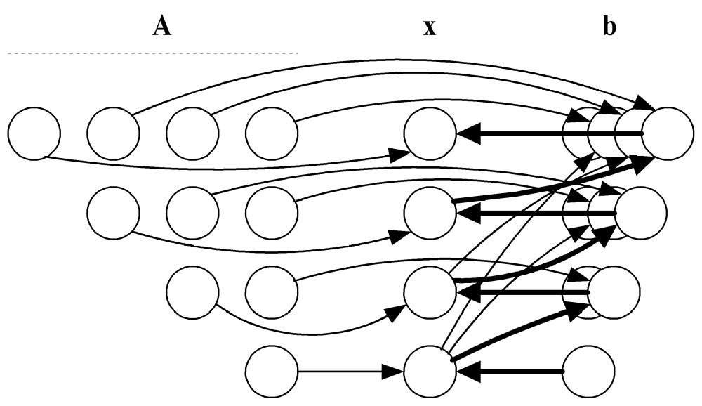
Data Dependence Diagram
We cannot execute the outer loop in parallel.
We can execute the inner loop in parallel.

Slide 20
Row-oriented Algorithm
Associate primitive task with each row of A and corresponding elements of x and b
During iteration i task associated with row j computes new value of b_{j}
Task i must compute x_{i} and broadcast its value
Agglomerate using rowwise interleaved striped decomposition

Slide 21
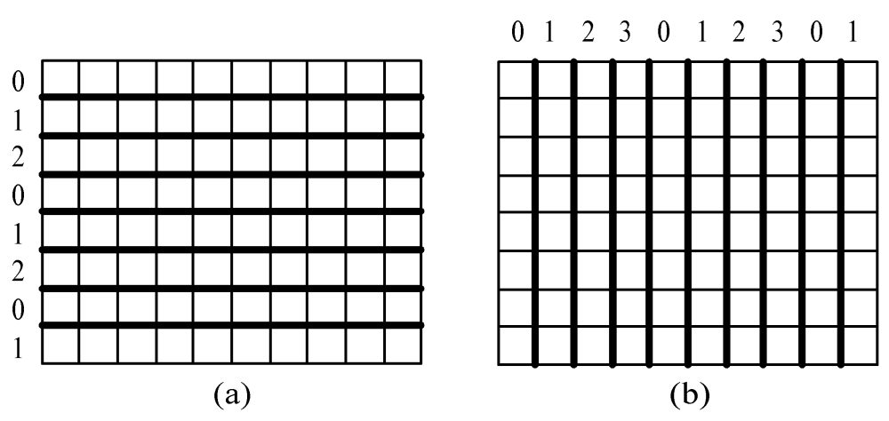
Interleaved Decompositions
Rowwise interleaved
striped decomposition
Columnwise interleaved
striped decomposition

Slide 22
Complexity Analysis
Each process performs about n / (2p) iterations of loop j in all
A total of n -1 iterations in all
Computational complexity: Θ(n²/p)
One broadcast per iteration
Communication complexity: Θ(n log p)

Slide 23
Gaussian Elimination
Used to solve Ax = b when A is dense
Reduces Ax = b to upper triangular system Tx = c
Back substitution can then solve Tx = c
for x

Slide 24
Gaussian Elimination
4x₀
+6x₁
+2x₂
– 2x₃
=
8
2x₀
+5x₂
– 2x₃
=
4
–4x₀
– 3x₁
– 5x₂
+4x₃
=
1
8x₀
+18x₁
– 2x₂
+3x₃
=
40

Slide 25
Gaussian Elimination
4x₀
+6x₁
+2x₂
– 2x₃
=
8
– 3x₁
+4x₂
– 1x₃
=
0
+3x₁
– 3x₂
+2x₃
=
9
+6x₁
– 6x₂
+7x₃
=
24

Slide 26
Gaussian Elimination
4x₀
+6x₁
+2x₂
– 2x₃
=
8
– 3x₁
+4x₂
– 1x₃
=
0
1x₂
+1x₃
=
9
2x₂
+5x₃
=
24

Slide 27
Gaussian Elimination
4x₀
+6x₁
+2x₂
– 2x₃
=
8
– 3x₁
+4x₂
– 1x₃
=
0
1x₂
+1x₃
=
9
3x₃
=
6

Slide 28
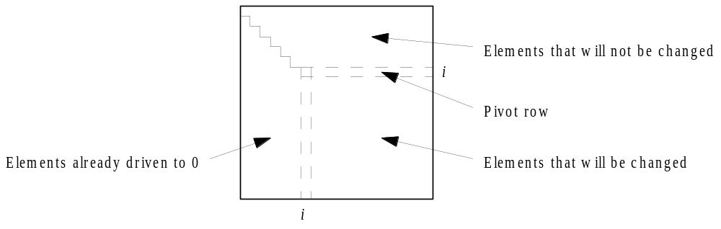
Iteration of Gaussian Elimination

Slide 29
Numerical Stability Issues
If pivot element close to zero, significant roundoff errors can result
Gaussian elimination with partial pivoting eliminates this problem
In step i we search rows i through n-1 for the row whose column i element has the largest absolute value
Swap (pivot) this row with row i

Slide 30
Row-oriented Parallel Algorithm
Associate primitive task with each row of A and corresponding elements of x and b
A kind of reduction needed to find the identity of the pivot row
Tournament: want to determine identity of row with largest value, rather than largest value itself
Could be done with two all-reductions
MPI provides a simpler, faster mechanism

Slide 31
MPI_MAXLOC, MPI_MINLOC
MPI provides reduction operators MPI_MAXLOC, MPI_MINLOC
Provide datatype representing a (value, index) pair

Slide 32
MPI (value,index) Datatypes
MPI_Datatype | Meaning
MPI_2INT | Two ints
MPI_DOUBLE_INT | A double followed by an int
MPI_FLOAT_INT | A float followed by an int
MPI_LONG_INT | A long followed by an int
MPI_LONG_DOUBLE_INT | A long double followed by an int
MPI_SHORT_INT | A short followed by an int

Slide 33
Example Use of MPI_MAXLOC
struct {
double value;
int index;
} local, global;
...
local.value = fabs(a[j][i]);
local.index = j;
...
MPI_Allreduce (&local, &global, 1,
MPI_DOUBLE_INT, MPI_MAXLOC,
MPI_COMM_WORLD);

Slide 34
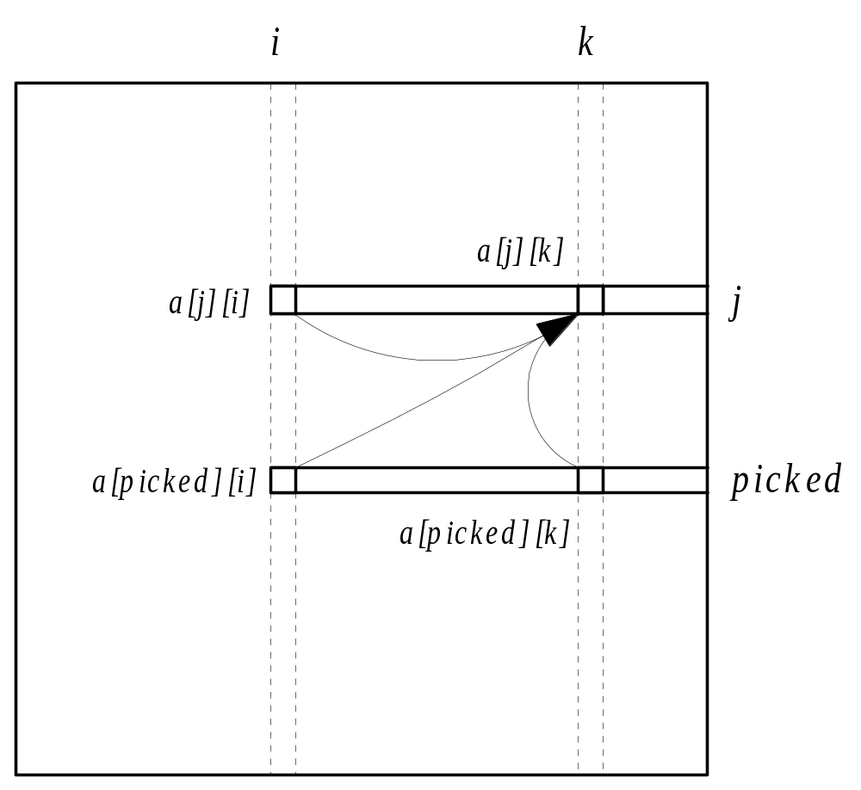
Second Communication per Iteration

Slide 35
Communication Complexity
Complexity of tournament: Θ(log p)
Complexity of broadcasting pivot row:
Θ(n log p)
A total of n - 1 iterations
Overall communication complexity:
Θ(n² log p)

Slide 36
Column-oriented Algorithm
Associate a primitive task with each column of A and another primitive task for b
During iteration i task controlling column i determines pivot row and broadcasts its identity
During iteration i task controlling column i must also broadcast column i to other tasks
Agglomerate tasks in an interleaved fashion to balance workloads
Isoefficiency same as row-oriented algorithm

Slide 37
Comparison of Two Algorithms
Both algorithms evenly divide workload
Both algorithms do a broadcast each iteration
Difference: identification of pivot row
  Row-oriented algorithm does search in parallel but requires all-reduce step
  Column-oriented algorithm does search sequentially but requires no communication
Row-oriented superior when n relatively larger and p relatively smaller

Slide 38
Problems with These Algorithms
They break parallel execution into computation and communication phases
Processes not performing computations during the broadcast steps
Time spent doing broadcasts is large enough to ensure poor scalability

Slide 39
Pipelined, Row-Oriented Algorithm
Want to overlap communication time with computation time
We could do this if we knew in advance the row used to reduce all the other rows.
Let’s pivot columns instead of rows!
In iteration i we can use row i to reduce the other rows.

Slide 40
Communication Pattern
0
Reducing Using
Row 0
Row 0
3
1
2

Slide 41
Communication Pattern
0
Reducing Using
Row 0
3
Reducing Using
Row 0
1
Row 0
2

Slide 42
Communication Pattern
0
Reducing Using
Row 0
3
Reducing Using
Row 0
1
Row 0
2
Reducing Using
Row 0

Slide 43
Communication Pattern
0
Reducing Using
Row 0
3
Reducing Using
Row 0
1
Reducing Using
Row 0
2
Reducing Using
Row 0

Slide 44
Communication Pattern
0
3
Reducing Using
Row 0
1
Reducing Using
Row 0
2
Reducing Using
Row 0

Slide 45
Communication Pattern
0
3
Reducing Using
Row 0
1
Reducing Using
Row 1
Row 1
2
Reducing Using
Row 0

Slide 46
Communication Pattern
0
3
Reducing Using
Row 0
1
Reducing Using
Row 1
Row 1
2
Reducing Using
Row 1

Slide 47
Communication Pattern
0
Row 1
3
Reducing Using
Row 1
1
Reducing Using
Row 1
2
Reducing Using
Row 1

Slide 48
Communication Pattern
0
Reducing Using
Row 1
3
Reducing Using
Row 1
1
Reducing Using
Row 1
2
Reducing Using
Row 1

Slide 49
Analysis
Total computation time: Θ(n³/p)
Total message transmission time: Θ(n²)
When n large enough, message transmission time completely overlapped by computation time
Message start-up not overlapped: Θ(n)
Parallel overhead: Θ(np)

Slide 50
Sparse Systems
Gaussian elimination not well-suited for sparse systems
Coefficient matrix gradually fills with nonzero elements
Result
  Increases storage requirements
  Increases total operation count

Slide 51
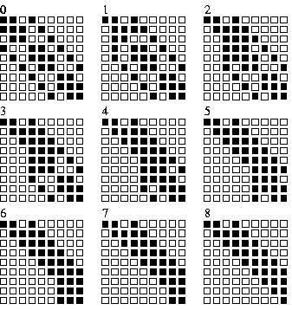
Example of “Fill”

Slide 52
Iterative Methods
Iterative method: algorithm that generates a series of approximations to solution’s value
Require less storage than direct methods
Since they avoid computations on zero elements, they can save a lot of computations

Slide 53
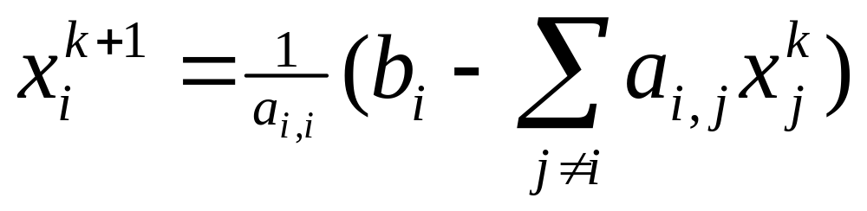

Jacobi Method
Values of elements of vector x at iteration k+1
depend upon values of vector x at iteration k
Gauss-Seidel method: Use latest version
available of x_{i}

Slide 54
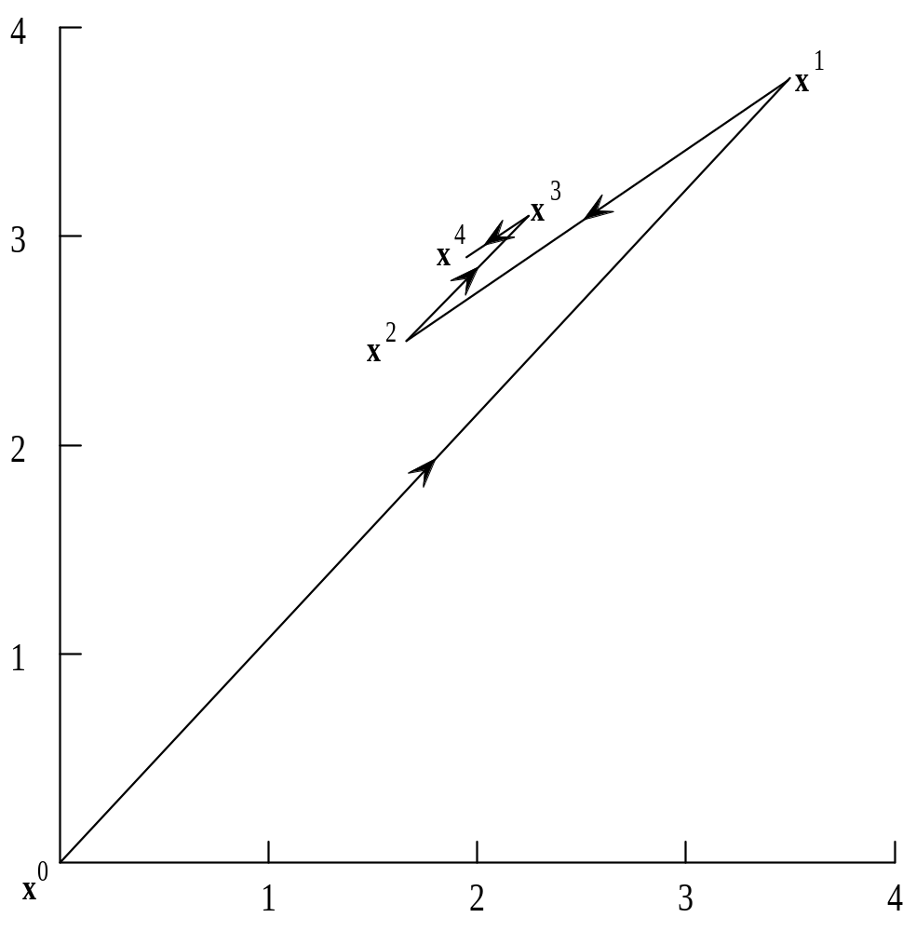
Jacobi Method Iterations

Slide 55
Rate of Convergence
Even when Jacobi method and Gauss-Seidel methods converge on solution, rate of convergence often too slow to make them practical
We will move on to an iterative method with much faster convergence

Slide 56
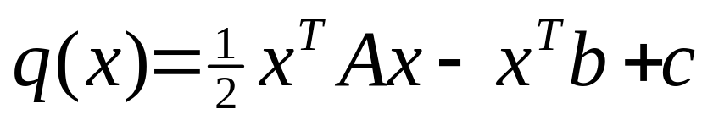
Conjugate Gradient Method
A is positive definite if for every nonzero vector x and its transpose x^{T}, the product x^{T}Ax > 0
If A is symmetric and positive definite, then the function
has a unique minimizer that is solution to Ax = b
Conjugate gradient is an iterative method that solves Ax = b by minimizing q(x)

Slide 57
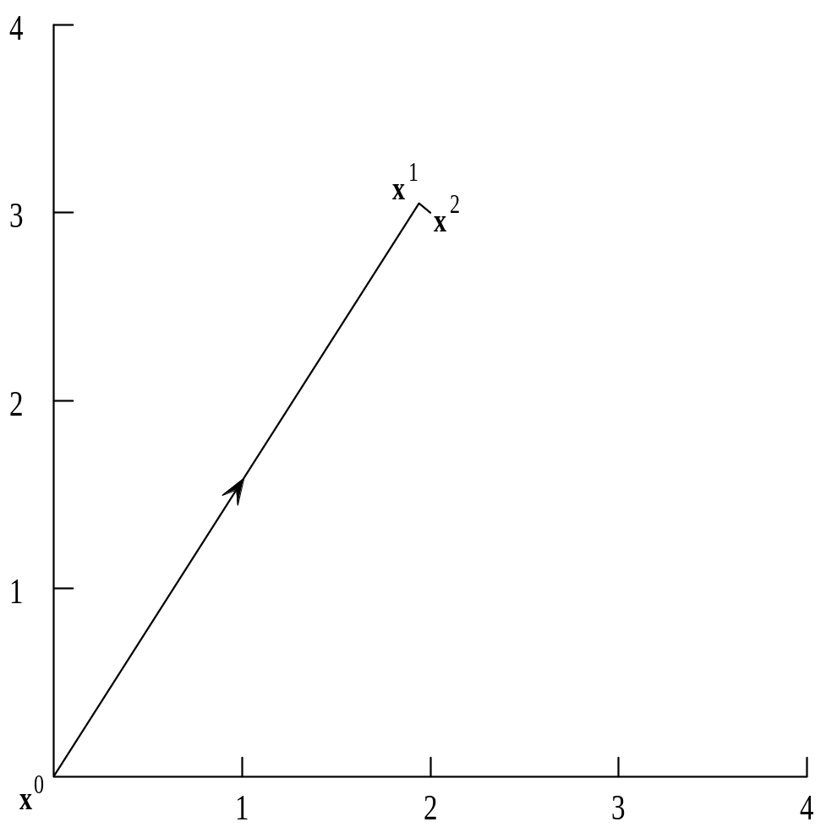
Conjugate Gradient Convergence
Finds value of
n-dimensional solution
in at most n iterations

Slide 58
Conjugate Gradient Computations
Matrix-vector multiplication
Inner product (dot product)
Matrix-vector multiplication has higher time complexity
Must modify previously developed algorithm to account for sparse matrices

Slide 59
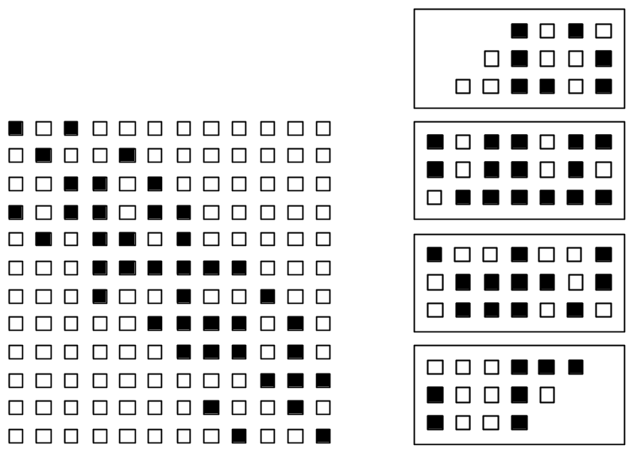
Rowwise Block Striped Decomposition of a Symmetrically Banded Matrix
Decomposition
Matrix

Slide 60
Representation of Vectors
Replicate vectors
  Need all-gather step after matrix-vector multiply
  Inner product has time complexity Θ(n)
Block decomposition of vectors
  Need all-gather step before matrix-vector multiply
  Inner product has time complexity
  Θ(n/p + log p)

Slide 61
Summary
Solving systems of linear equations
  Direct methods
  Iterative methods
Parallel designs for
  Back substitution
  Gaussian elimination
  Conjugate gradient method

